Slide 1
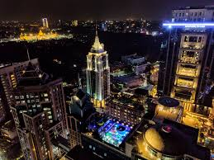
Exploring neighborhood’s in Bangalore, India for opening a shopping mall using Foursquare API

Slide 2
Background
For many shoppers, visiting shopping malls is a great way to relax and enjoy themselves during weekends and holidays. They can do grocery shopping, dine at restaurants, shop at the various fashion outlets, watch movies and perform many more activities. Shopping malls are like a one-stop destination for all types of shoppers. For retailers, the central location and the large crowd at the shopping malls provides a great distribution channel to market their products and services. Property developers are also taking advantage of this trend to build more shopping malls to cater to the demand. As a result, there are many shopping malls in the city of Bangalore and many more are being built. Opening shopping malls allows property developers to earn consistent rental income. Of course, as with any business decision, opening a new shopping mall requires serious consideration and is a lot more complicated than it seems. Particularly, the location of the shopping mall is one of the most important decisions that will determine whether the mall will be a success or a failure.

Slide 3
Targeted audience
This project is particularly useful to property developers and investors looking to open or invest in new shopping malls in Bangalore. This project is timely as the city is currently suffering from oversupply of shopping malls.

Slide 4
Data
List of neighbourhoods in Bangalore. This defines the scope of this project which is confined to the city of Bangalore, the capital city of Karnataka state in India.
Latitude and longitude coordinates of those neighbourhoods. This is required in order to plot the map and also to get the venue data.
Venue data, particularly data related to shopping malls. We will use this data to perform clustering on the neighbourhoods.

Slide 5
Sources of data and methods to extract them
This Wikipedia page (https://en.wikipedia.org/wiki/List_of_neighbourhoods_in_Bangalore) contains a list of neighbourhoods in Bagalore, with a total of 145 neighbourhoods.
we will use Foursquare API to get the venue data for those neighbourhoods. Foursquare has one of the largest database of 105+ million places and is used by over 125,000 developers.

Slide 6
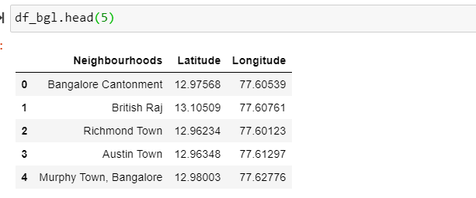
Dataframe created

Slide 7
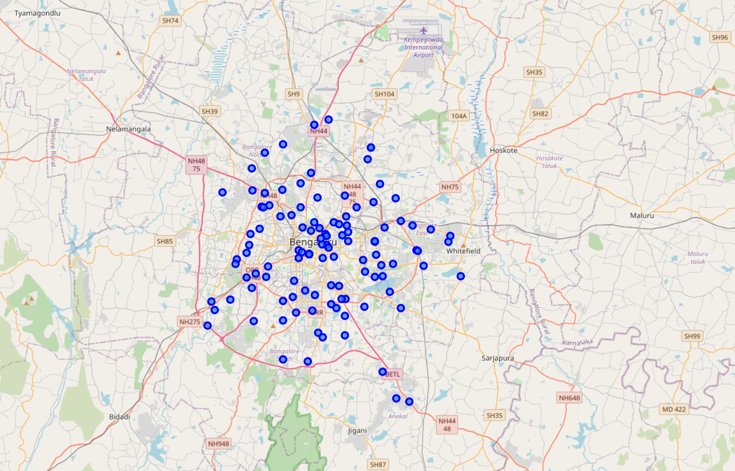
Maps with geographical location of the neighbourhood:

Slide 8
Next, we will use Foursquare API to get the top 100 venues that are within a radius of 2000 meters. We need to register a Foursquare Developer Account in order to obtain the Foursquare ID and Foursquare secret key. We then make API calls to Foursquare passing in the geographical coordinates of the neighbourhoods in a Python loop. Foursquare will return the venue data in JSON format and we will extract the venue name, venue category, venue latitude and longitude. With the data, we can check how many venues were returned for each neighbourhood and examine how many unique categories can be curated from all the returned venues. Then, we will analyse each neighbourhood by grouping the rows by neighbourhood and taking the mean of the frequency of occurrence of each venue category. By doing so, we are also preparing the data for use in clustering. Since we are analysing the “Shopping Mall” data, we will filter the “Shopping Mall” as venue category for the neighbourhoods.

Slide 9
Lastly, we will perform clustering on the data by using k-means clustering. K-means clustering algorithm identifies k number of centroids, and then allocates every data point to the nearest cluster, while keeping the centroids as small as possible. It is one of the simplest and popular unsupervised machine learning algorithms and is particularly suited to solve the problem for this project. We will cluster the neighbourhoods into 3 clusters based on their frequency of occurrence for “Shopping Mall”. The results will allow us to identify which neighbourhoods have higher concentration of shopping malls while which neighbourhoods have fewer number of shopping malls. Based on the occurrence of shopping malls in different neighbourhoods, it will help us to answer the question as to which neighbourhoods are most suitable to open new shopping malls.

Slide 10
Results :
The results from the k-means clustering show that we can categorize the neighbourhoods into 3 clusters based on the frequency of occurrence for “Shopping Mall”:
Cluster 0: Neighbourhoods with high concentration of shopping malls
Cluster 1: Neighbourhoods with low number to no existence of shopping malls
Cluster 2: Neighbourhoods with moderate number of shopping malls
The results of the clustering are visualized in the map below with cluster 0 in red colour, cluster 1 in purple colour, and cluster 2 in mint green colour

Slide 11
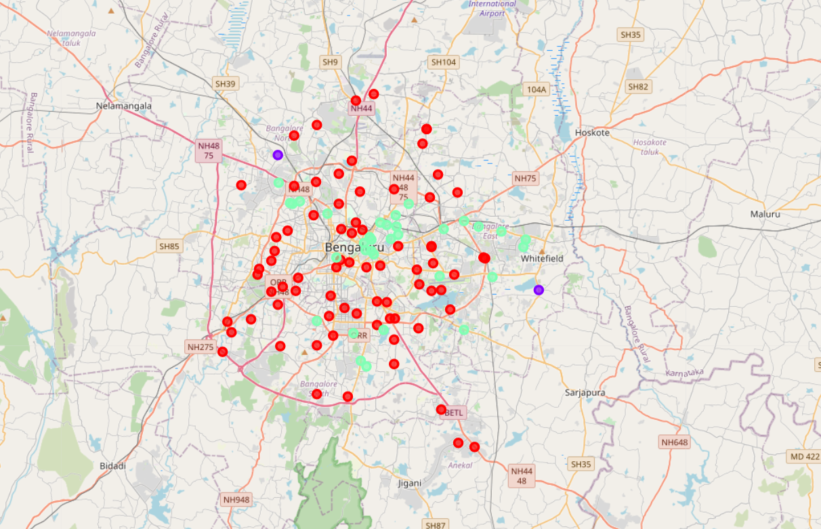

Slide 12
Discussion
As observations noted from the map in the Results section, most of the shopping malls are concentrated in the central area of Bangalore city, with the highest number in cluster 0 and moderate number in cluster 2. On the other hand, cluster 1 has very low number to no shopping mall in the neighbourhoods. This represents a great opportunity and high potential areas to open new shopping malls as there is very little to no competition from existing malls. Meanwhile, shopping malls in cluster 0 are likely suffering from intense competition due to oversupply and high concentration of shopping malls. From another perspective, the results also show that the oversupply of shopping malls mostly happened in the central area of the city, with the suburb area still have very few shopping malls. Therefore, this project recommends property developers to capitalize on these findings to open new shopping malls in neighbourhoods in cluster 1 with little to no competition. Property developers with unique selling propositions to stand out from the competition can also open new shopping malls in neighbourhoods in cluster 2 with moderate competition. Lastly, property developers are advised to avoid neighbourhoods in cluster 0 which already have high concentration of shopping malls and suffering from intense competition.

Slide 13
Limitations and Suggestions for Future Research
In this project, we only consider one factor i.e. frequency of occurrence of shopping malls, there are other factors such as population and income of residents that could influence the location decision of a new shopping mall. However, to the best knowledge of this researcher such data are not available to the neighbourhood level required by this project. Future research could devise a methodology to estimate such data to be used in the clustering algorithm to determine the preferred locations to open a new shopping mall. In addition, this project made use of the free Sandbox Tier Account of Foursquare API that came with limitations as to the number of API calls and results returned. Future research could make use of paid account to bypass these limitations and obtain more results.

Slide 14
Conclusion
In this project, we have gone through the process of identifying the business problem, specifying the data required, extracting and preparing the data, performing machine learning by clustering the data into 3 clusters based on their similarities, and lastly providing recommendations to the relevant stakeholders i.e. property developers and investors regarding the best locations to open a new shopping mall. To answer the business question that was raised in the introduction section, the answer proposed by this project is: The neighbourhoods in cluster 1 are the most preferred locations to open a new shopping mall. The findings of this project will help the relevant stakeholders to capitalize on the opportunities on high potential locations while avoiding overcrowded areas in their decisions to open a new shopping mall

